Slide 1
Lecture-11
F₀ extraction

Slide 2
Sophisticated model for speech production
Simplified model for speech production
Voiced
Pitch period, N
G
Periodic Impulse
Train Generator
G(z)
Glottal
filter
V
H(z)
Vocal Tract
Filter
R(z)
Lip
Radiation
Filter
x(n)
Speech
Signal
Uncorrelated
Noise
Generator
U
G
Unvoiced
Pitch period, N
Voiced
Periodic Impulse
Train Generator
Voiced/unvoiced
switch
V
Combined
Filter
x(n)
Speech
Signal
Random
Sequence
Generator
U
G
Unvoiced

Slide 3
Simplified Speech Source Model
unvoiced
voiced
G(z), G(ω), g[n]
random
sequence
generator
G(z) =
x[n]
×
u[n]
1
1− ∑ a_{k}z^{-k}
P
k = 1
periodic pulse train
generator
G
v/u
Vocal Tract Model
N
Excitation
  Excitation parameters
  v/u : voiced/ unvoiced
  N : pitch for voiced
  G : signal gain
  → excitation signal u[n]
  Vocal Tract parameters
  {a_{k}} : LPC coefficients
  →formant structure of speech signals
  A good approximation, though not
  precise enough

Slide 4
Time Domain
Zero-Crossing Detection
Autocorrelation Function
Average Magnitude Difference Function

Slide 5
Zero-Crossing Detection based F0 detection
Based on a direct application of the definition of periodicity
Counting the number of time that the signal crosses a reference level
If the spectral power of the waveform is concentrated around f0, then it will cross the zero line twice per cycle
Mostly Inexpensive in computation
Weakness against noise
Presents weakness when used to analyze signals with energy in high frequencies

Slide 6
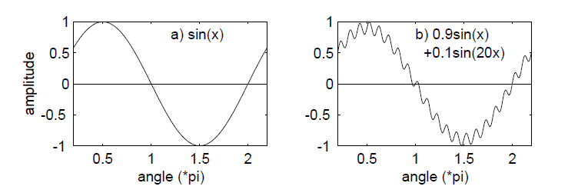

Slide 7

Autocorrelation Technique
Autocorrelation is a cross-correlation of a signal with itself.
  The maximum of similarity occurs for time shifting of zero.
  An other maximum should occur in theory when the time-shifting of the signal corresponds to the fundamental period.

Slide 8
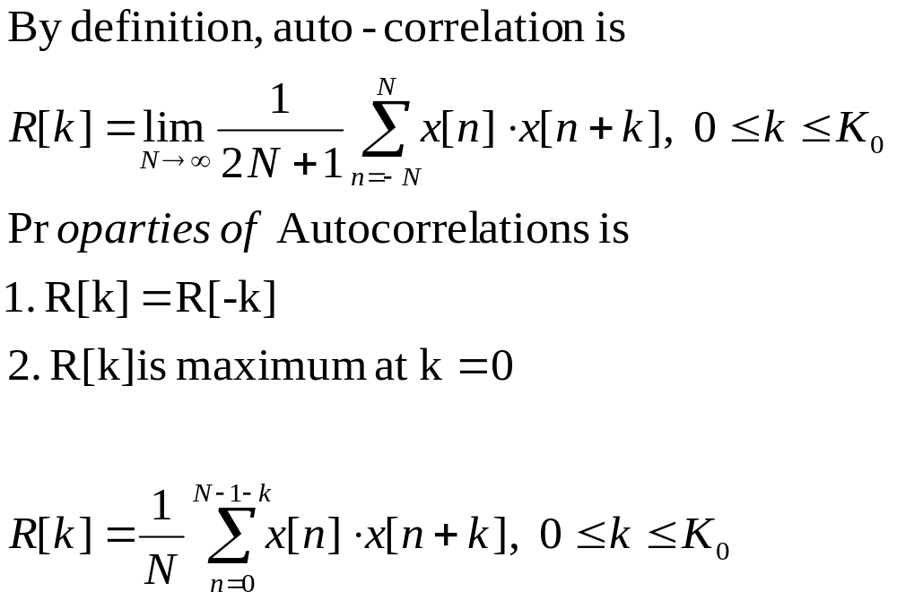
Autocorrelation function
Ch4. pitch, v3.a

Slide 9
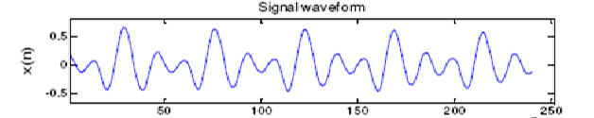
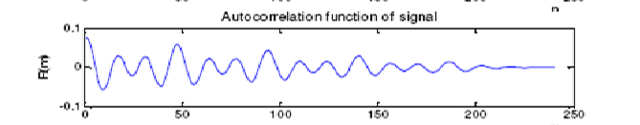
T₀
T₀
T₀
When a segment of a signal is correlated with itself, the distance (Lag_time_in_samples) between the positions of the maximum and the second maximum is defined as the fundamental period (pitch) of the signal.

Slide 10
The result can be enhanced by
Center clipping
Using cross-correlation
Filtering the speech signal
  Pitch range is 40 – 400 Hz (40-200 Hz for male, and 200-400 Hz for female)

Slide 11
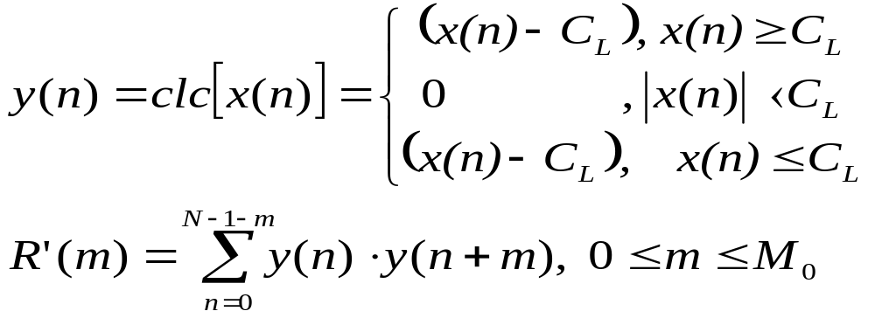
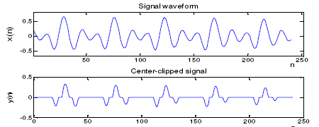
Center clipping
Typical C_{L} =1/4 peak-to-peak of X

Slide 12
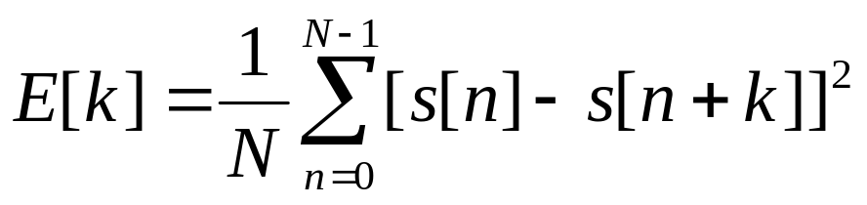
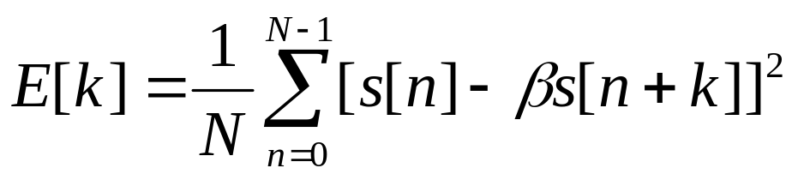
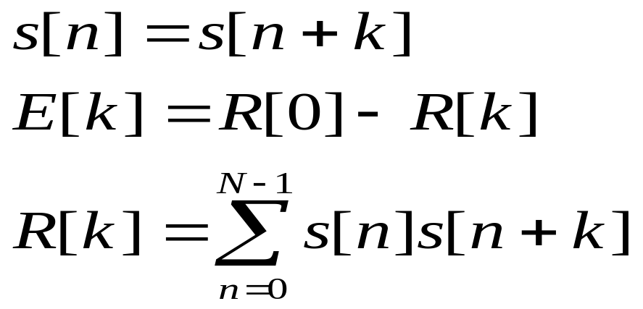
Normalized cross correlation function NCCF method
Due to onset offsets
β Is scaling factor
Since the signal is stationary
Hence

Slide 13
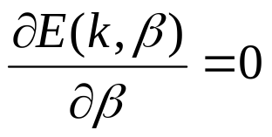
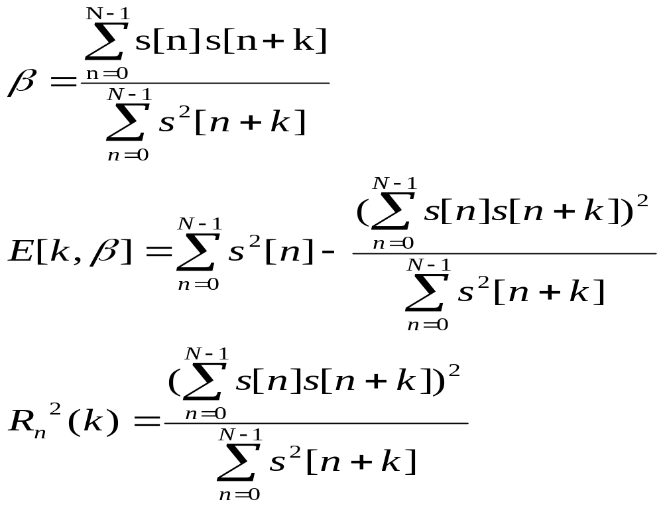
By setting in equation (1)

Slide 14
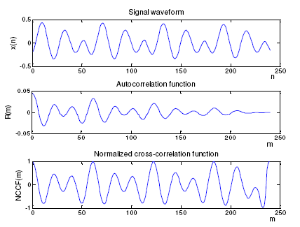

Slide 15
Autocorrelation Technique
  Not very efficient for high fundamental frequency.
  Convolution is a very expensive process.
  Computation efficiency can be improved using the FFT algorithm instead of convolution. It reduces calculation from N squared to N logN.
  Most of the variation of this technique related to the mathematical definition of the autocorrelation used, the way the maximums are localized, and how errors in the maximum identification are attenuated.

Slide 16
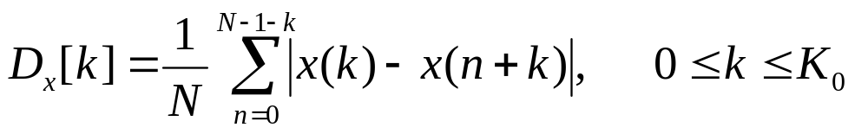
Average Magnitude Difference Function(AMDF)
It is an alternate to Autocorrelation function.
It compute the difference between the signal and a time-shifted version of itself.
  While autocorrelation have peaks at maximum similarity, there will be valleys in the average magnitude difference function.

Slide 17
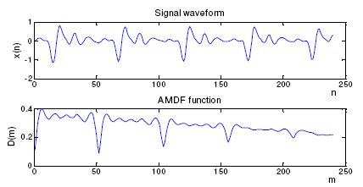

Slide 18
Less computational complex so suitable for H/W implementation
Performance is poor and it does not cater for variation in the energy of the speech

Slide 19
Other Temporal Algorithm
Waveform Maximum Detection
Sum Magnitude Difference Squared Function
Average Squared Difference Function
Cumulative Mean Normalized Difference Function
Circular Average Magnitude Difference Function
Adaptive Filter

Slide 20
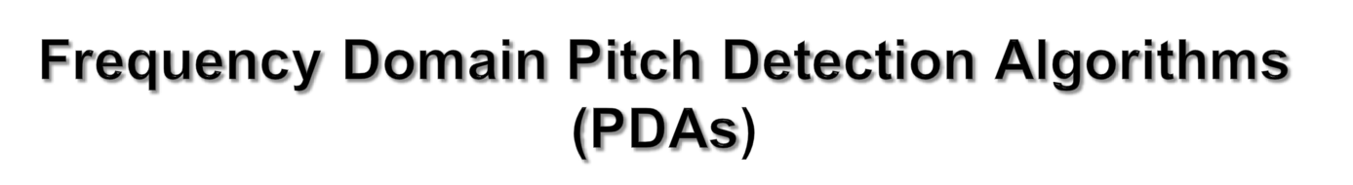
Frequency domain PDAs operate on speech spectrum.
Distance between harmonics is the fundamental frequency, or inverse of the pitch period.
Main drawback of frequency domain PDAs is high computational complexity.

Slide 21
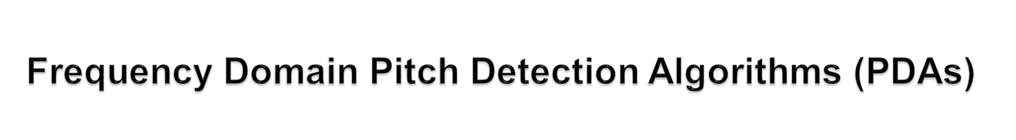
Two kinds of frequency PDAs are:
  Harmonic Peak Detection
  Spectrum Similarity

Slide 22
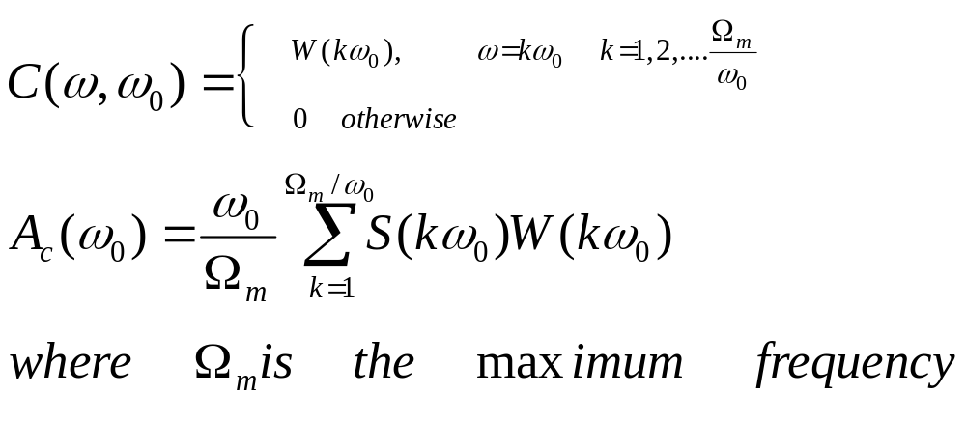
Detect all harmonic peaks.
Get the fundamental frequency by recognizing it as the common divisor or the spacing of adjacent harmonics.
This can be done using a comb filter.

Slide 23
Assumes that the spectrum is fully voiced and is composed only of harmonics located at multiples of the pitch frequency.
Synthetic spectrum is created from each frequency candidate and compared to original spectrum.
Best one to match the original spectrum is selected as the fundamental frequency.

Slide 24


Combine results from time domain algorithms and frequency domain algorithms to provide a better pitch estimate.
E.g. Autocorrelation for time and frequency domain is given by :

Slide 25
Periodic Similarity
Peakiness of Speech
Zero Crossing
Spectrum Tilt

Slide 26
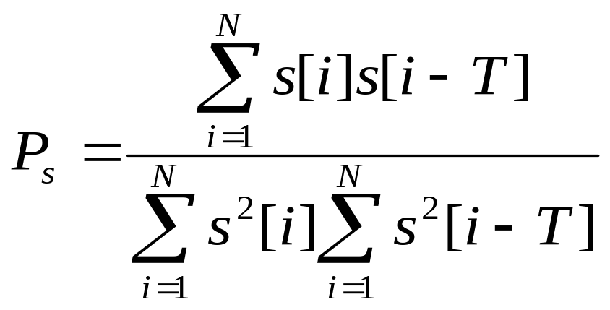
Most prominent characteristic that separates voiced speech from unvoiced speech is its regularity and fairly well-defined pitch.

Slide 27
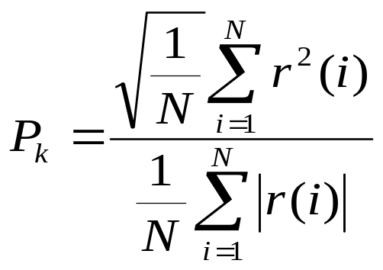
Voiced speech contains regular pulses which do not appear in unvoiced speech.
Unvoiced speech, however, may contain a few random spikes and in these cases, those frame may be incorrectly labeled as voiced.
LPC residue is used to compute its value

Slide 28
Number of times unvoiced speech crosses the zero line is significantly higher than that of voiced speech.
Gender of speaker can also have an effect on zero crossing.
Small pitch weighting can be used to weight the decision threshold.

Slide 29
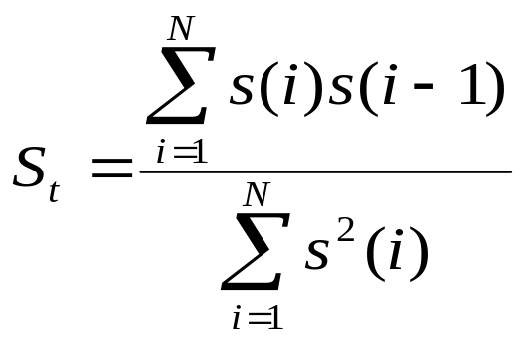
Voiced speech has higher energy in low frequencies and unvoiced speech has higher energy in high frequencies.
Can avoid individual spikes in low-level signals.

